Slide 1

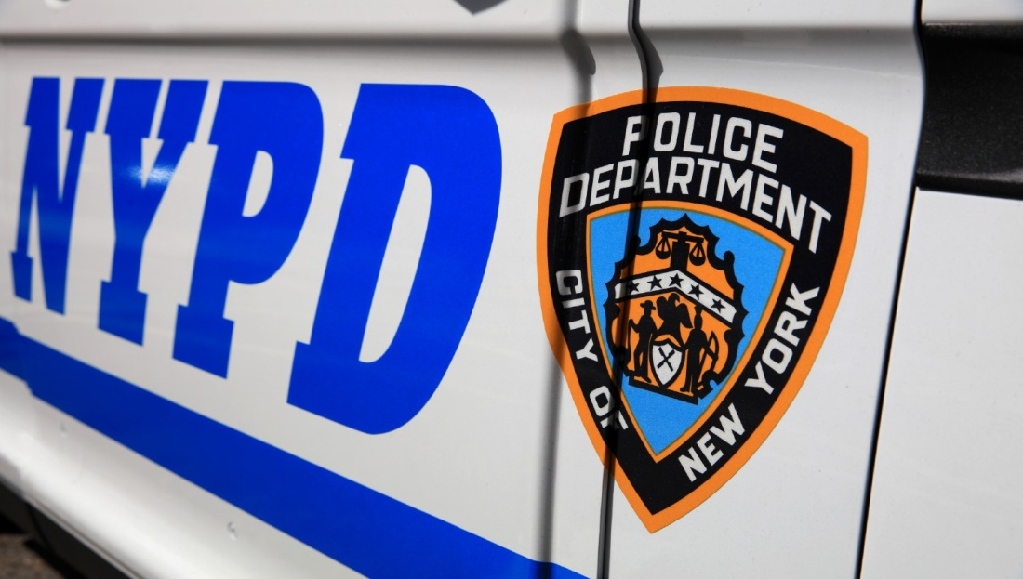
NYPD HATE CRIMES: WHAT CAN WE LEARN FROM CRIME DATA
Capstone Presentation By Muhammad Yousaf for Data Analytics 201

Slide 2
MOTIVATION
I investigated hate crimes, and it is important to me because I faced a lot of racism growing up.
I had to deal with hate crimes in school as well as outside of school in my neighborhood.
The main reason behind the racism was that I am a Muslim.
I got into numerous fights and arguments.
The racism was commonly seen from elementary school until the end of high school. From college onwards, it got much better.
People do not learn and accept others, despite the diversity in America. There are already so many different issues going on in the world, we should all learn to be inclusive.
There should be better parenting at home, and educational institutions should also come up with different plans or programs to resolve these issues.

Slide 3
DATA SOURCE
Data for this analysis was provided by NYC Open Data
Used the dataset from the following URL:
https://data.cityofnewyork.us/Public-Safety/NYPD-Hate-Crimes/bqiq-cu78

Slide 4




IMPORT
The following libraries were used for the analysis:
Pandas
Numpy
Seaborn
Matplotlib (including Pyplot)

Slide 5
DATA RESEARCH GOAL
What is the goal of your analysis/project? What are you trying to understand?
The goal of my analysis/project is to mainly compare 2 boroughs, Manhattan South and Staten Island. I want to show the hate crimes recorded by the NYPD, the manner in which the different types of crimes are categorized, and the different ethnic groups who have unfortunately faced these obstacles. I am trying to understand what the following factors: the different counties, types of offenses, and ethnic groups, have to do with hate crimes.

Slide 6
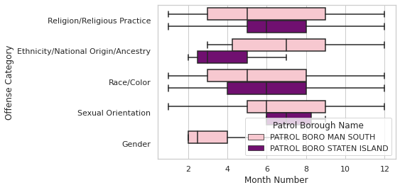
VISUALIZATION

Slide 7
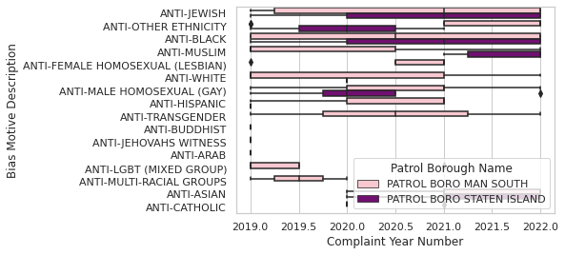
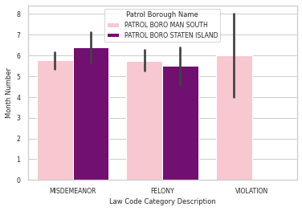
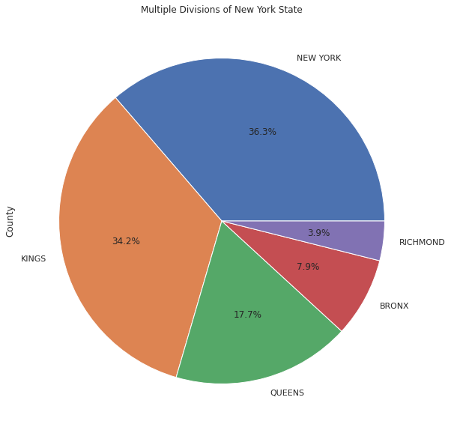

Slide 8
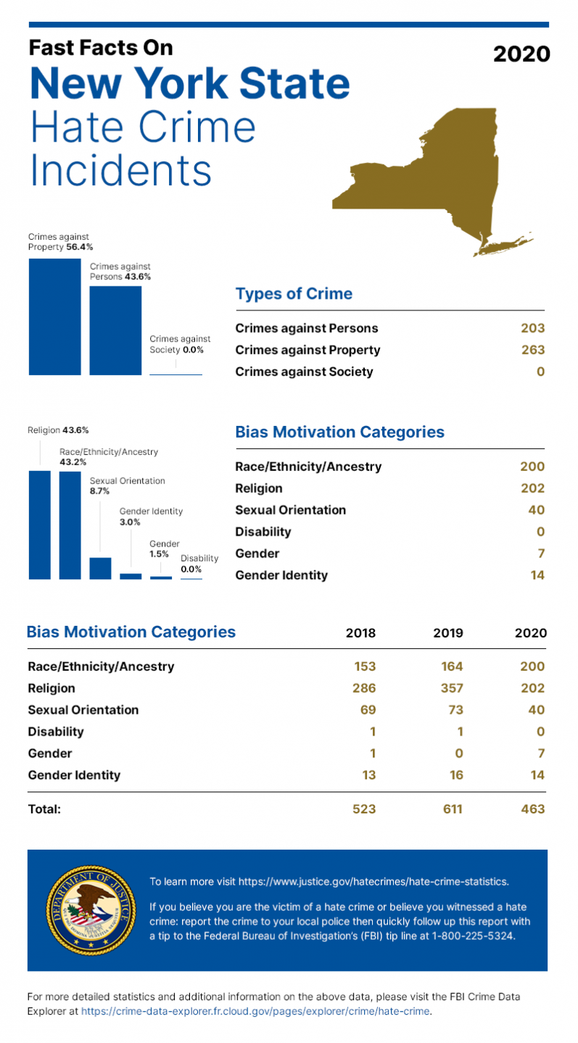
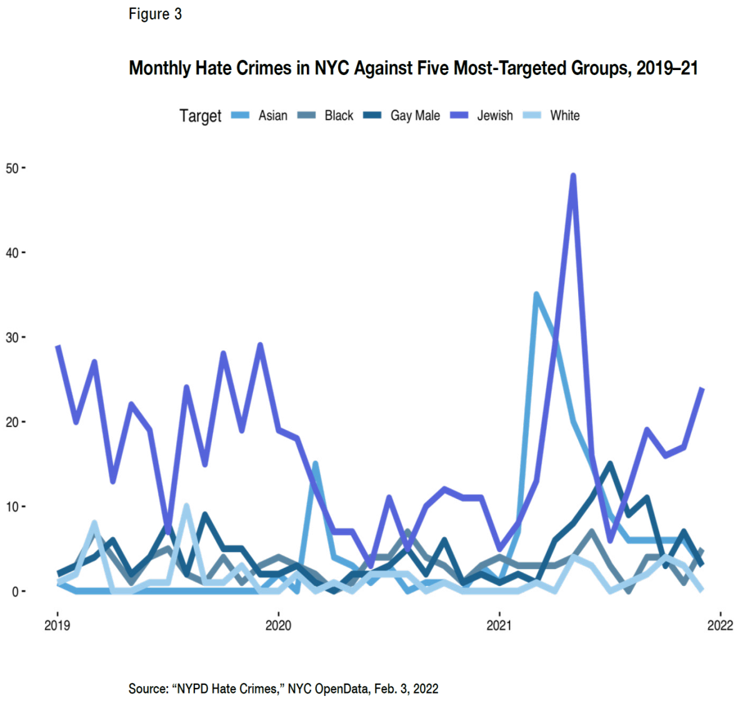
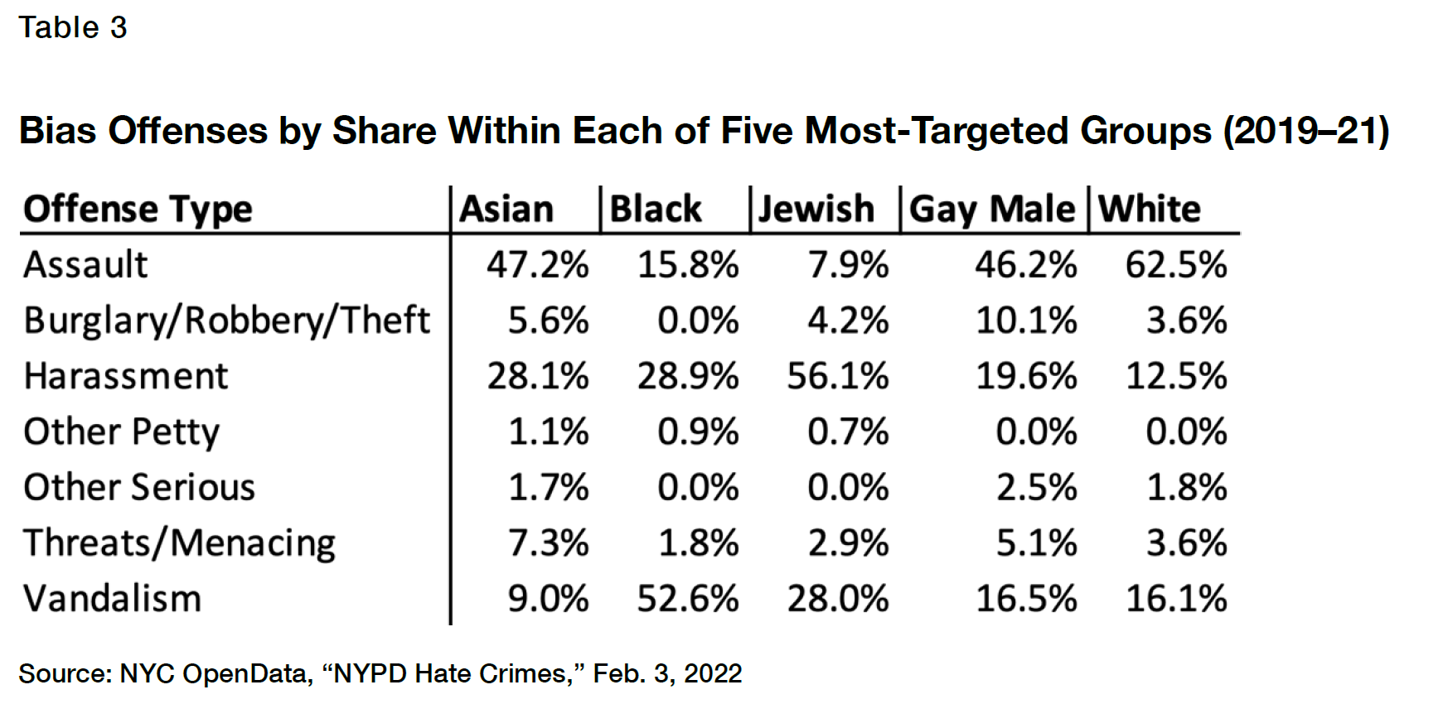

Slide 9
CONCLUSION
The following were the findings and final thoughts on the analysis:
Overall, more crimes occurred in New York county when compared with the other
counties.
Over the course of time, there were fluctuations in the number of complaints that
were recorded. The following was seen: inclines, declines, but there was barely any
steadiness). The most number of complaints were registered post-covid.
The most crimes that took place were from the petit larceny category, followed by
robberies. Both were seen the highest in Manhattan South. Most offenses occurred
due to one's religion/religious practices. The highest biased motives were anti-black.
By the middle of the year, more misdemeanors happened in Staten Island as
compared to Manhattan South. On the contrary, by the middle of the year, slightly
more felonies took place in Manhattan South in comparison to Staten Island. Also,
by mid-year, there were violations in Manhattan South, but not in Staten Island.

Slide 10
REFERENCES
Besides the two data sources that I provided in my second slide of this presentation, the following were used as guidelines:
Professor Imran Khan’s PowerPoint lectures
During our live lectures, I made some notes. So referred to those as well.
Google

Slide 11

THANK YOU
Courtesy
Professionalism
Respect

